Slide 1
Interrogate the Interface
by Grace Barry

Slide 2
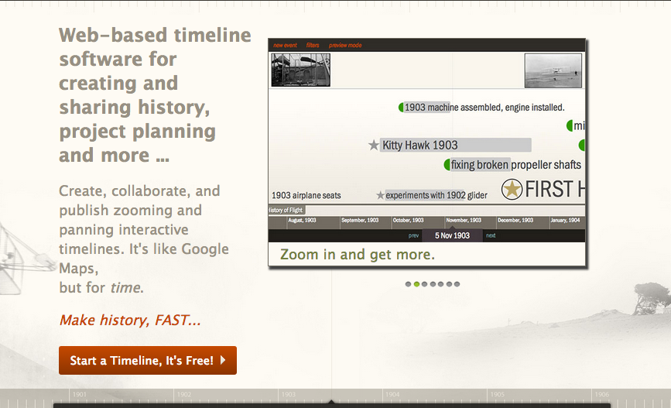
What is Timeglider?

Slide 3
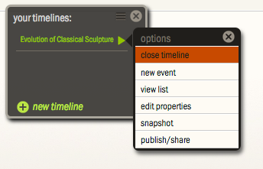
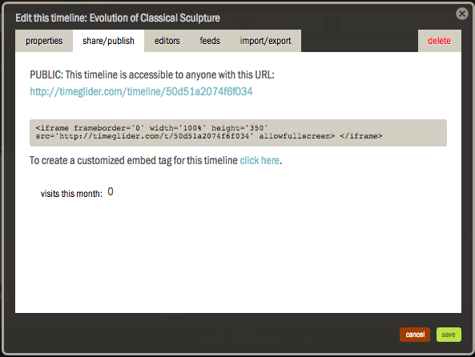
Audience
Educators and students
Businesses
Enthusiasts

Slide 4
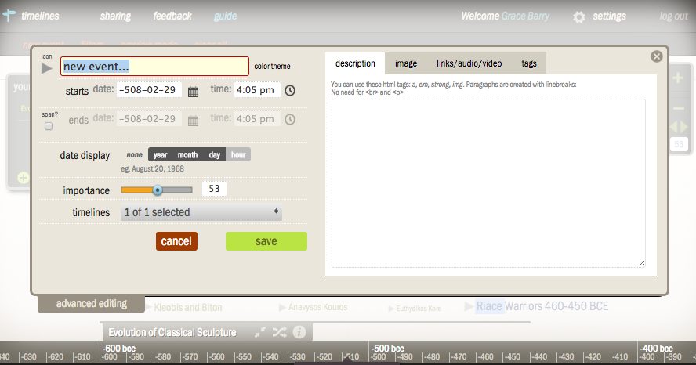
How it works

Slide 5
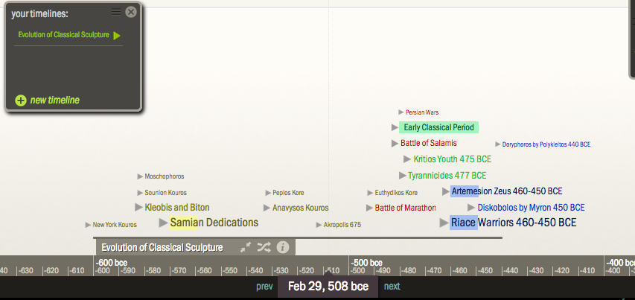
What it looks like

Slide 6
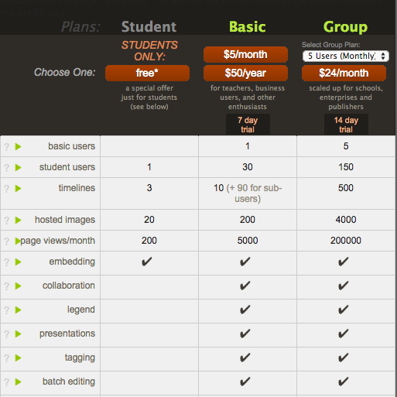
Pricing Student Basic Group

Slide 7
Affordances
Color coding
Adjust importance

Slide 8
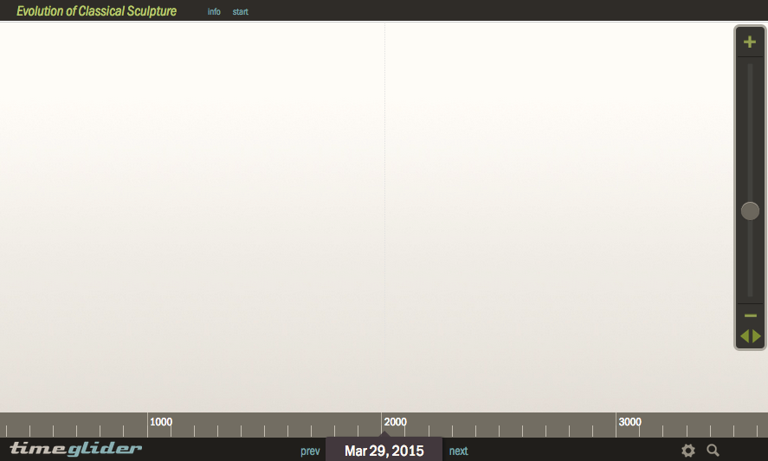
Constraints
Not interactive
Hard to navigate

Slide 9
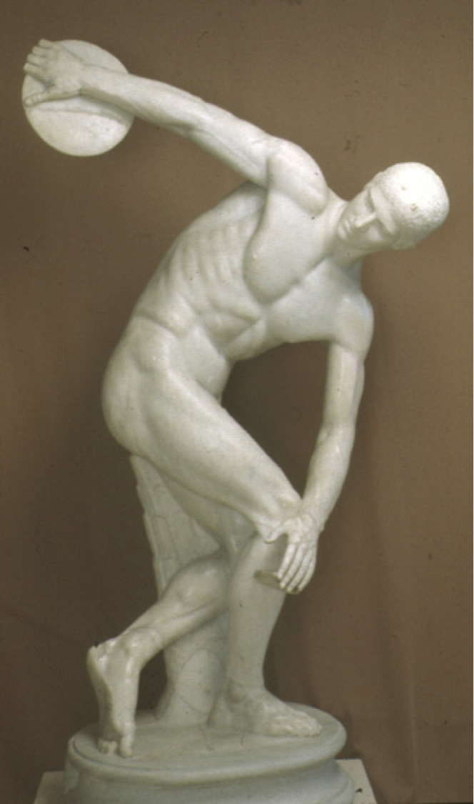
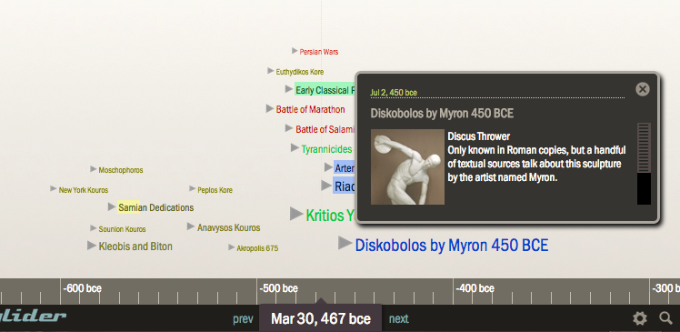
Constraints

Slide 10
Constraints

Slide 11
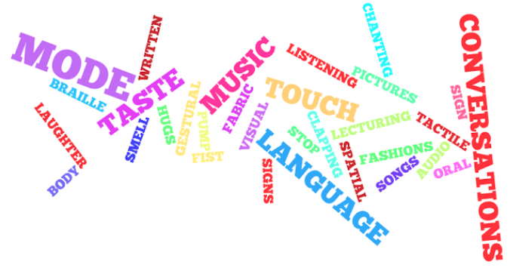
Modes of Communication
Linguistic, Spatial, Aural, Visual

Slide 12
Recommendation

