Slide 1
REMIX
A STORY
Anna Hubbard

Slide 2
THE STAR SPANGLED BANNER
http://en.wikipedia.org/wiki/Easy_Rider

Slide 3
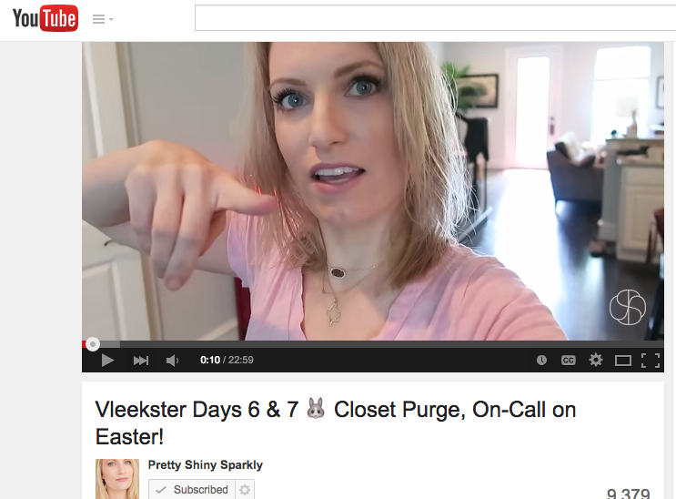
GENRE: Vlogs
https://www.youtube.com/watch?v=EU0ubn3ZjLA

Slide 4
AUDIENCE
Teens | 20 Somethings | YouTubers
http://blogs.sap.com/innovation/human-resources/millennials-always-02516496

Slide 5
GOALS
Share Story
Modernize
Humor

Slide 6
DESIGN
Chronological
Consistent
Emphasis

Slide 7
MODES OF COMMUNICATION:
ALL
http://knowyourmeme.com/photos/121951-wrong-lyrics-christina

Slide 8
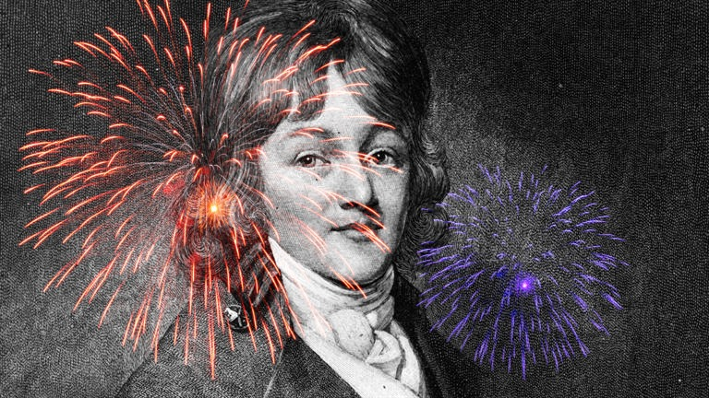
RISKS & CHALLENGES
Modernizing
Editing
http://www.biography.com/people/francis-scott-key-9364165

Slide 9
SUCCESSES
Modernization
Retaining Authenticity
http://thevalleyworks.org/?p=3882

Slide 10
DISSEMINATION
YouTube
Online Sharing

