Slide 1
The Princess and the Pea
Jackson Stitzer

Slide 2
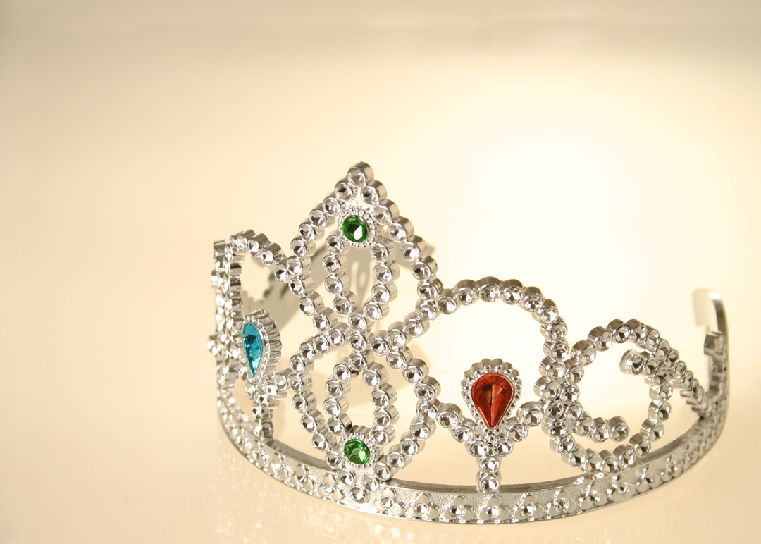
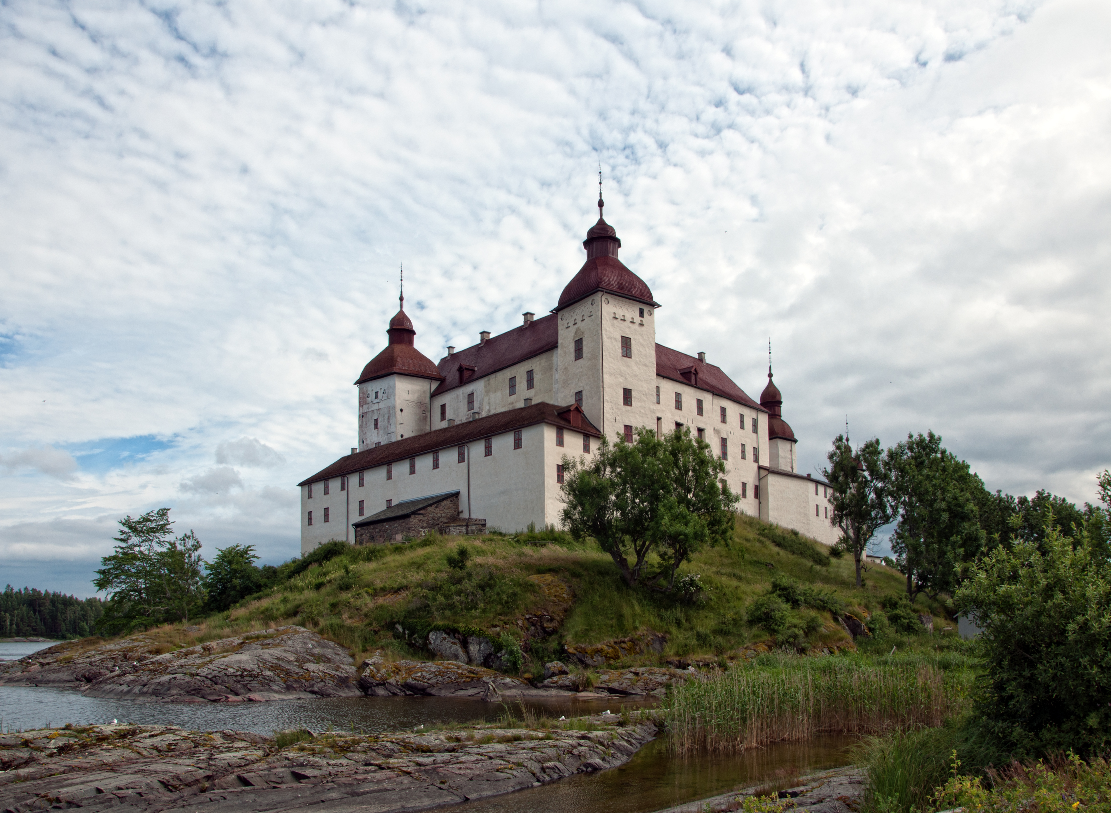
Purpose/Context

Slide 3
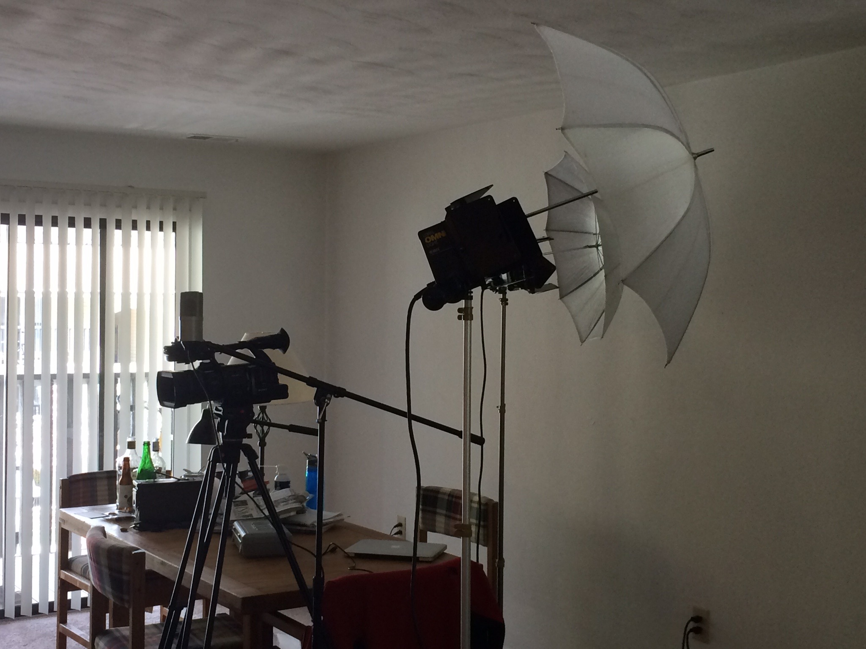
Design Choices
Setting
Cinematography
Lighting
Simplicity

Slide 4
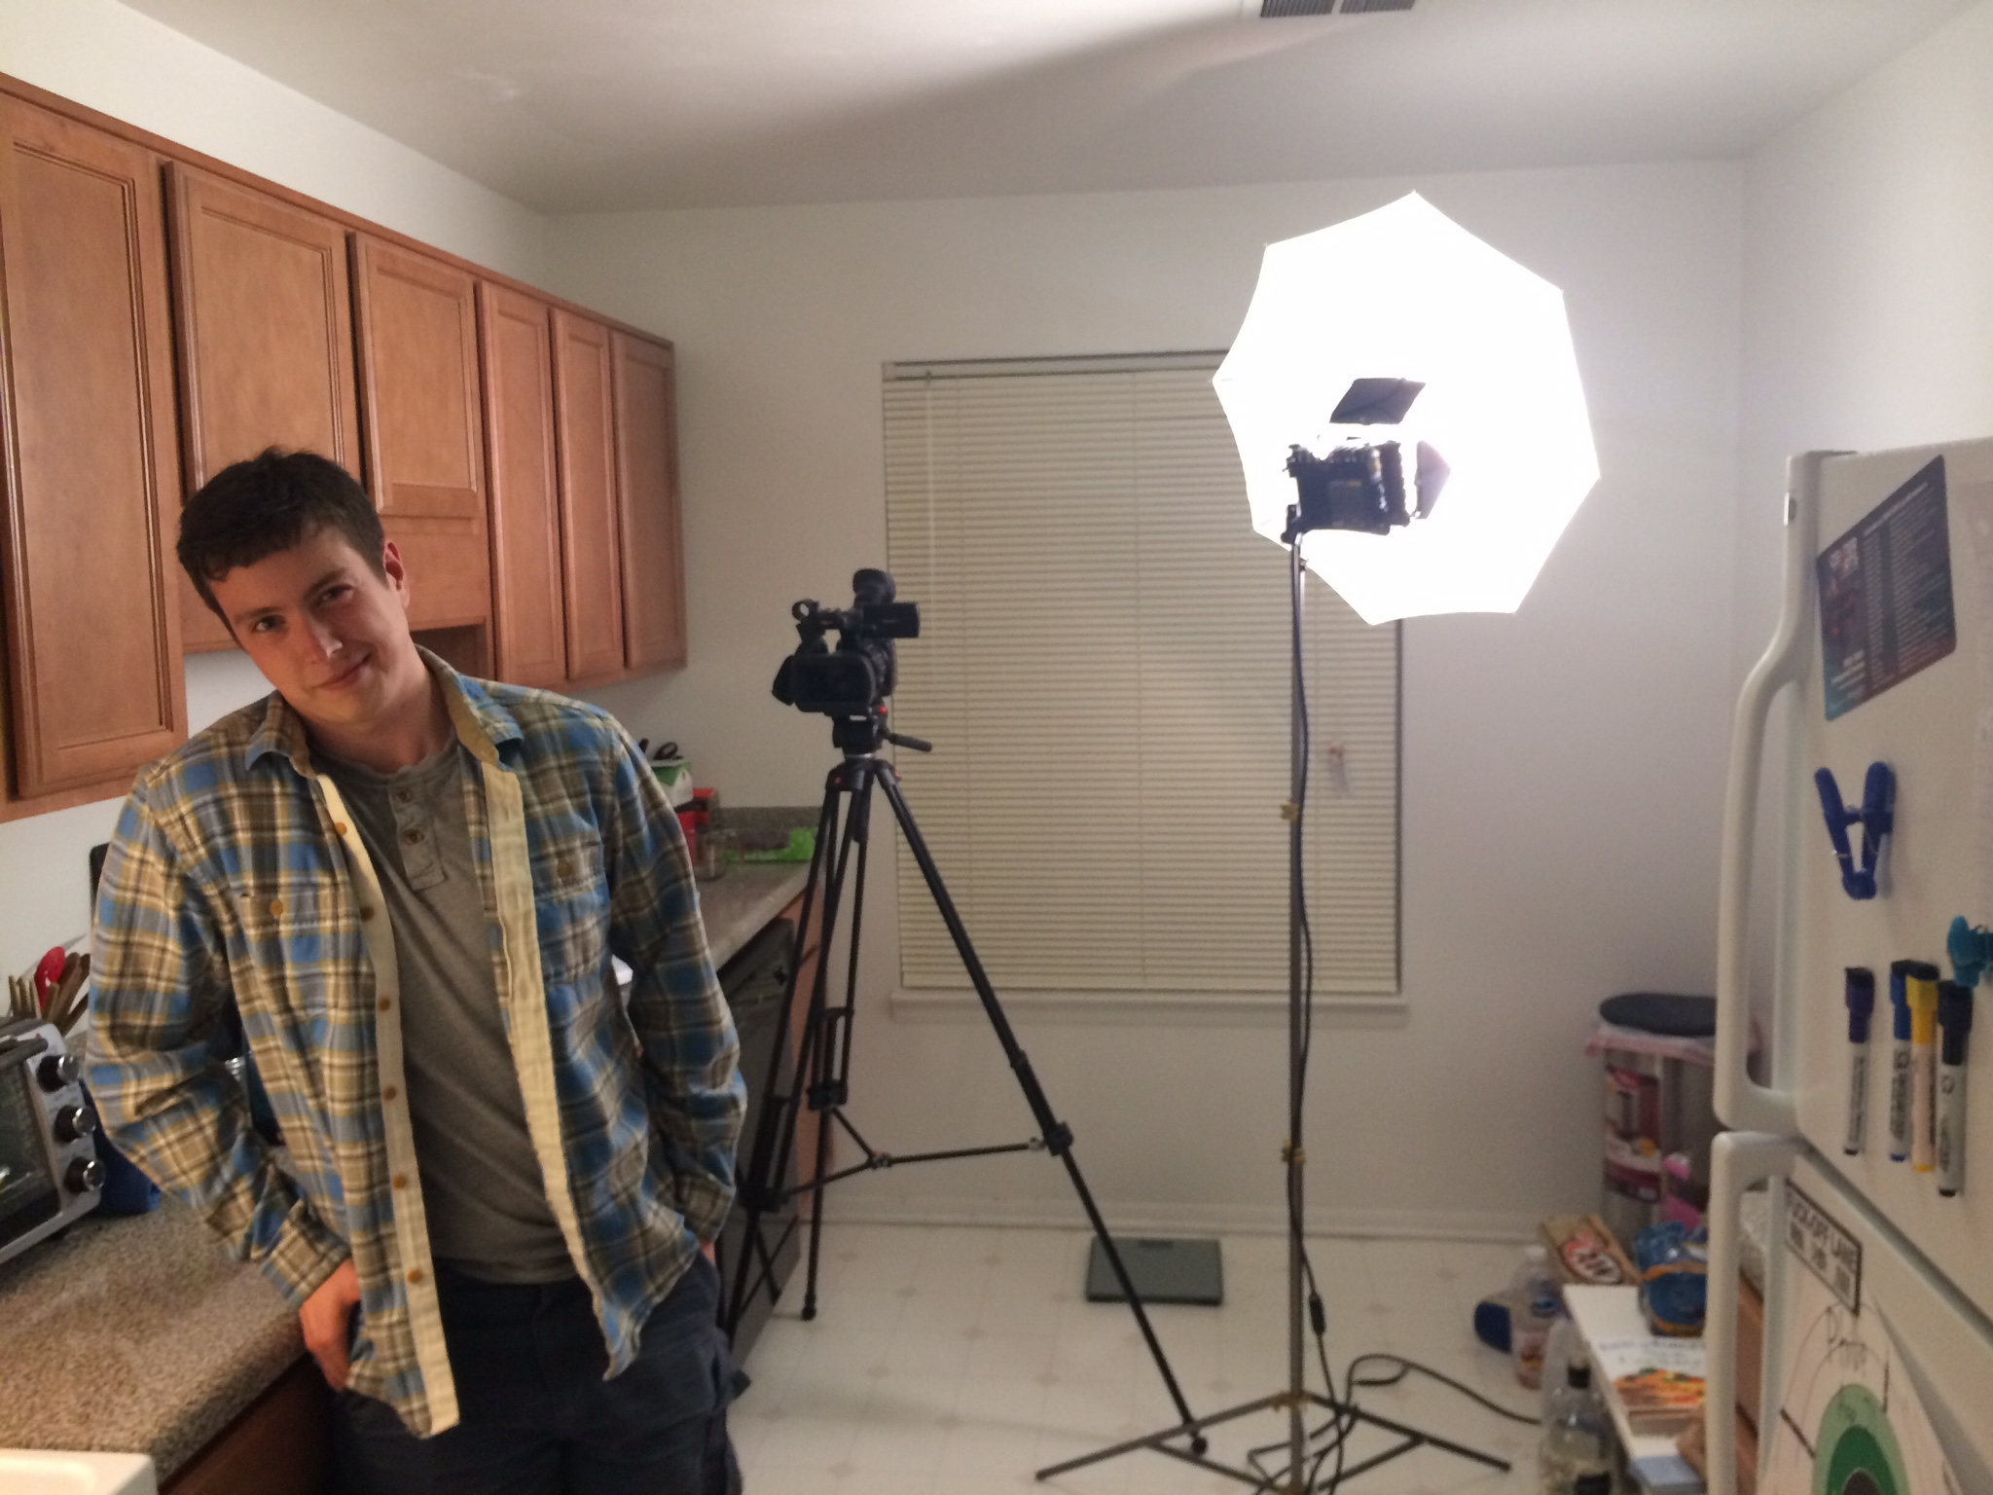
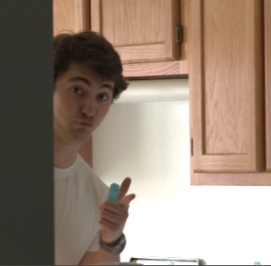
Challenges
Personnel
Time
Careless mistakes

Slide 5
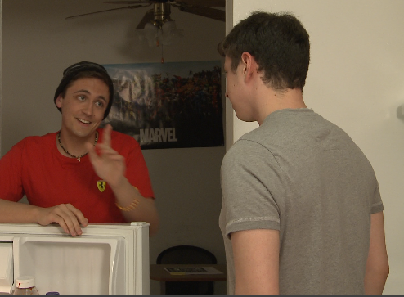
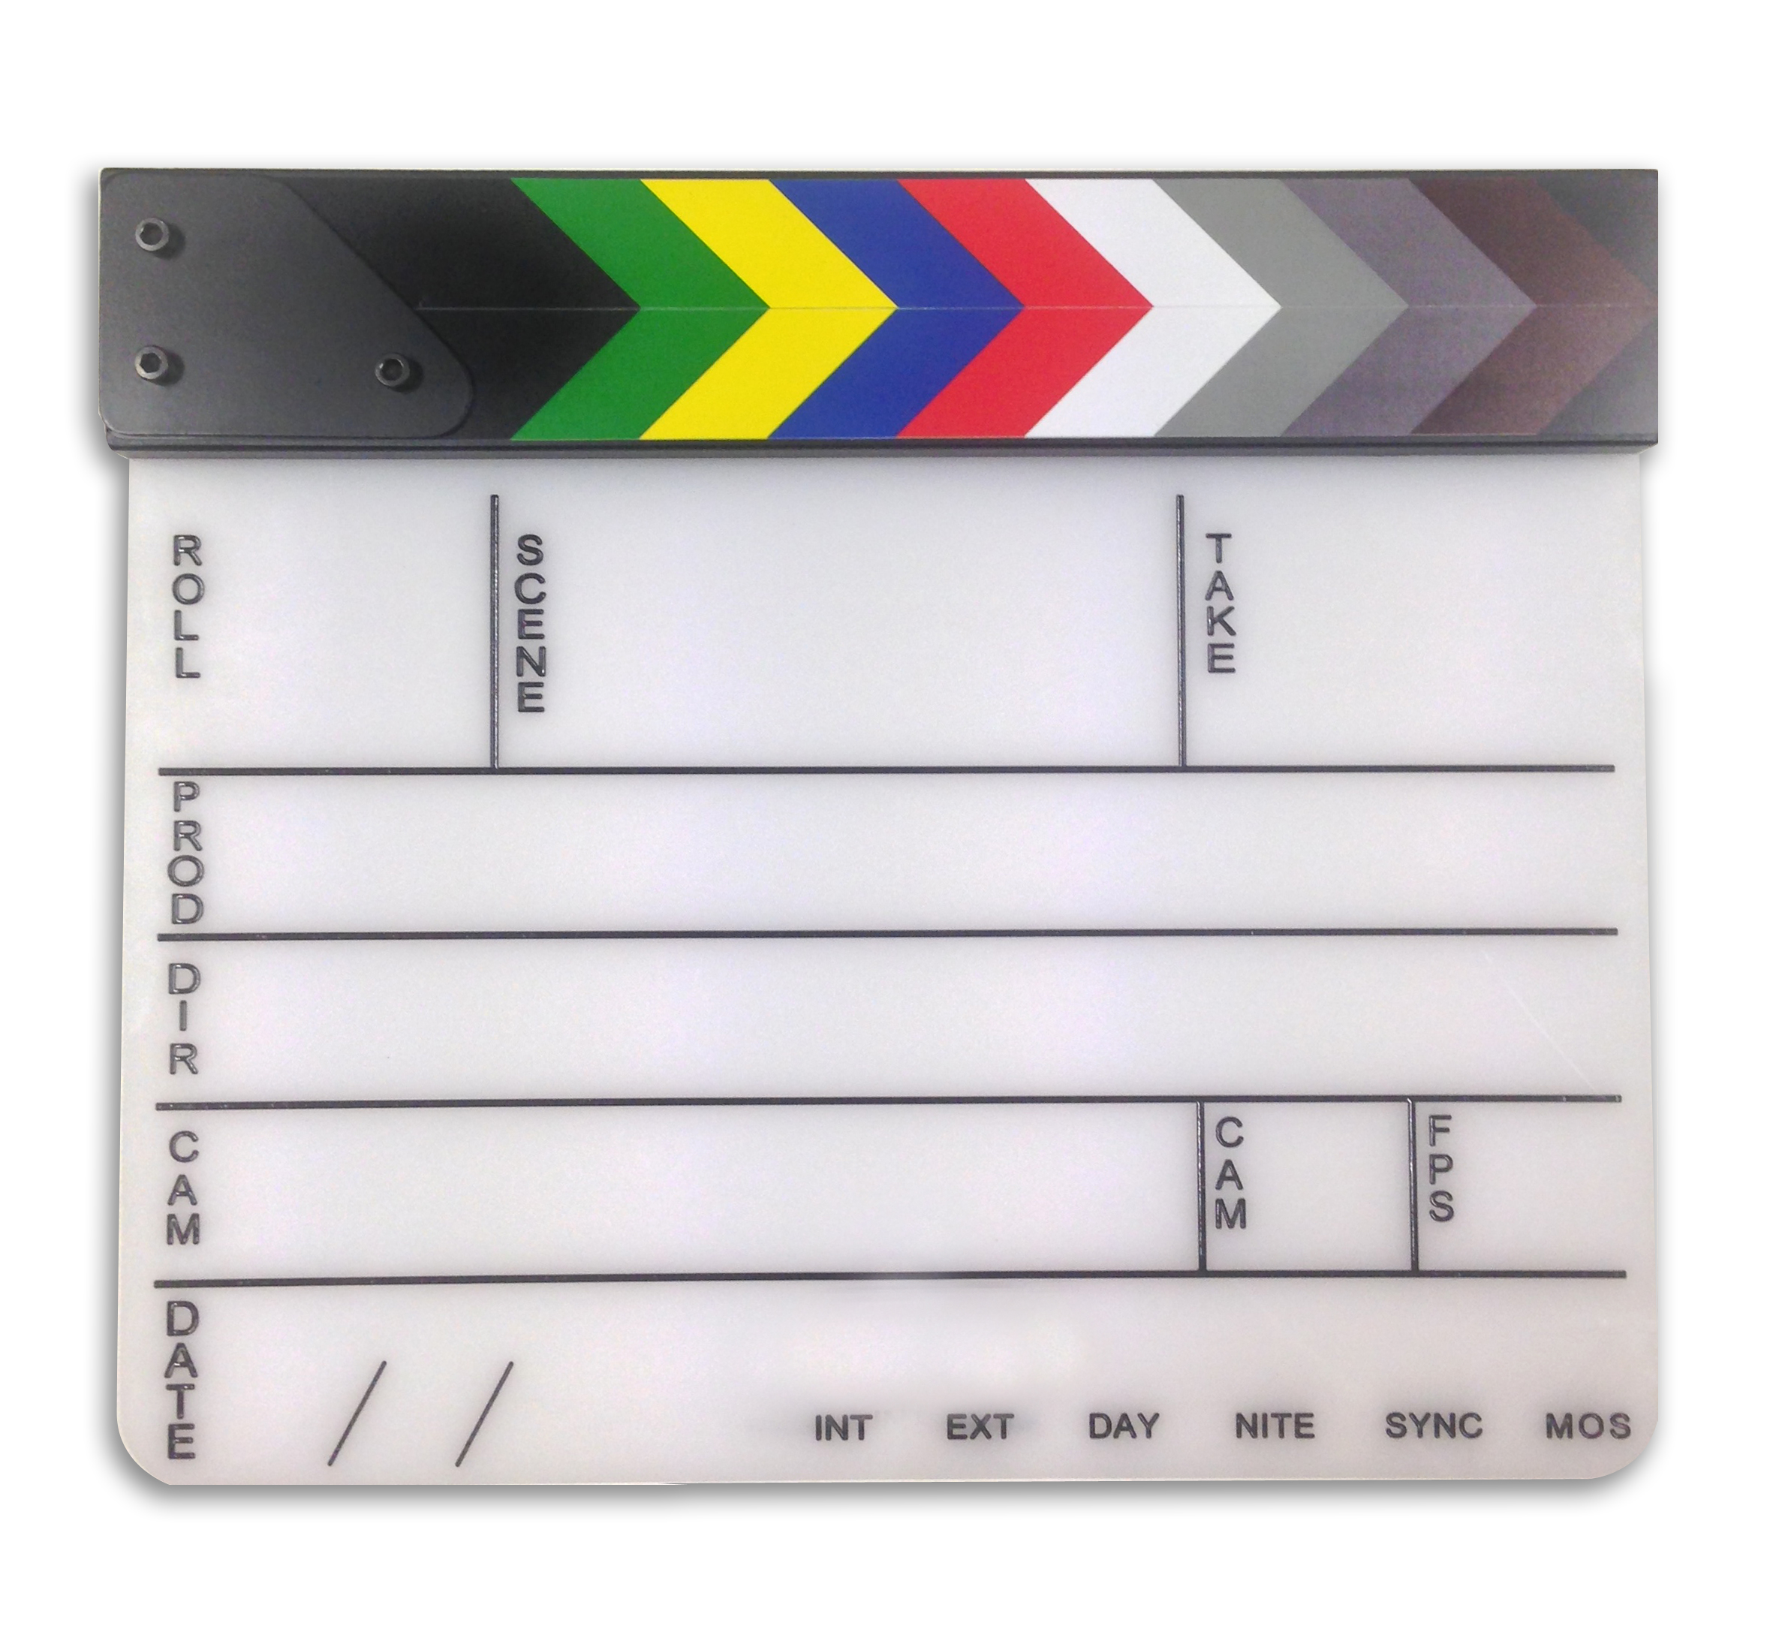
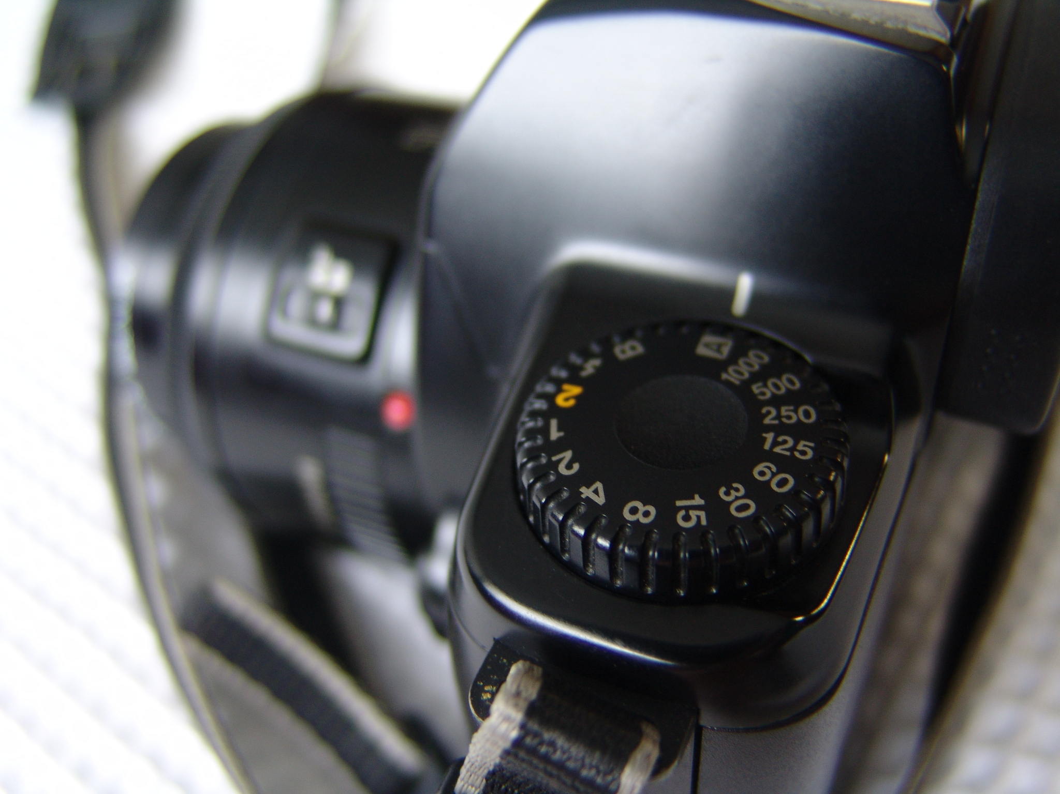
Next Time Around?
More actor prep.
More takes
More dynamic scenes

